Slide 1


Cyber Terrorism
By Biswajeet Ray

Slide 2

Cyber Terrorism
“Tomorrow’s terrorist may be able to do more damage with a keyboard than with a bomb”

Slide 3
Content
Introduction
Cyber terrorism
Common attack
Examples
Black Out Day
Traditional terrorism
Affect In Future
Need to do
Prevention & Protection
Conclusion

Slide 4
INTRODUCTION
As we know use of Internet is increasing day by day, traditional concepts and methods of terrorism have taken new dimensions.
 Individuals or groups can use the anonymity afforded by cyberspace to threaten citizens, specific groups (i.e. with membership based on ethnicity or belief), communities and even the countries.

Slide 5

What is Cyber terrorism???
Cyber terrorism is a phrase used to describe the use of Internet based attacks in terrorist activities, including acts of deliberate, large-scale disruption of computer networks, especially of personal computers attached to the Internet, by the means of tools such as computer viruses.

Slide 6
Features of Cyber Terrorism
Difficulty Identifying Attackers: It remains difficult to determine the identity of the initiators of most cyber attacks.
Lack of Boundaries: Attacks can originate from anywhere in the world and from multiple locations simultaneously.
Speed of Development: The time between the discovery of a new vulnerability and the emergence of a new tool or technique that exploits the vulnerability is getting shorter
Low Cost of Tools: The technology employed in attacks is simple to use, inexpensive, and widely available.
Automated Methods: The methods of attack have become automated and more sophisticated, resulting in greater damage from a single attack.

Slide 7
Examples of Cyber terrorism..
Hacking into computer systems.
Introducing viruses to vulnerable networks.
Website Defacing.
Denial-of-Service(DoS) attacks.
Terroristic threats made via e-mail.

Slide 8
How does Cyber Terrorism work?
Hacking : To gain access to (a computer file or network) illegally or without authorization.
Misinformation: To provide with incorrect information.
Virus: A computer program that duplicates itself in a manner that is harmful to normal computer use. Most viruses work by attaching themselves to another program. The amount of damage varies; viruses may erase all data or do nothing but reproduce themselves.
Worm: A malicious program that replicates itself until it fills all of the storage space on a drive or network.

Slide 9
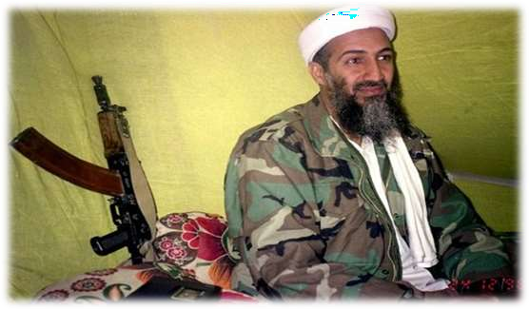
Who takes part in the act of cyber terrorism?
Terrorists- Anyone who terrorizes by using violence, threats, coercion, and/or intimidation as a way to instill fear and gain submission.

Slide 10
3 most common attack methods
IP spoofing.
Password Cracking.
Denial-of-service attacks.

Slide 11
IP Spoofing
Refers to creation of IP packets with forged source IP address with the purpose of concealing the identity of sender.
Mostly used in Denial-of-Service attacks.
Most effective in corporate networks where users can log in without a username or password.

Slide 12

Password Cracking
Password cracking can be implemented using brute-force attacks, Trojan horse programs and IP spoofing.
Password attacks usually refer to repeated attempts to identify a user account and/or password; these repeated attempts are called brute-force attacks.
One example is weak encryption(LM hash) used by Microsoft windows XP, can easily be attacked

Slide 13
Denial-of-Service attacks
Denial-of-service attacks focus on making a service unavailable to intended users.
2 forms of DoS attacks: those that crash services and those that flood services.
One common attack method involves saturating the target machine with communications requests such that it cannot respond to the traffic.

Slide 14








Cost of
Capability
Availability of Capability
1945
1955
1960
1970 1975
1985
Today

Slide 15
Examples of Cyber terrorist attacks:
9/11 attack.
Ahmedabad bomb blast.
26/11 Mumbai attack.

Slide 16
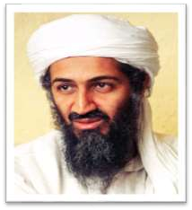

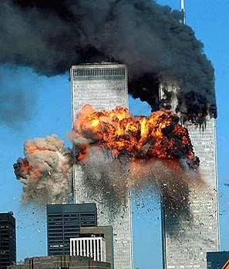
9/11 Twin Towers Attack
Al-Qaeda laptop was found in Afghanistan.
Hits on web sites that contained “Sabotage Handbook”.
Al-Qaeda actively researched publicly available information concerning critical infrastructures posted on web sites.

Slide 17

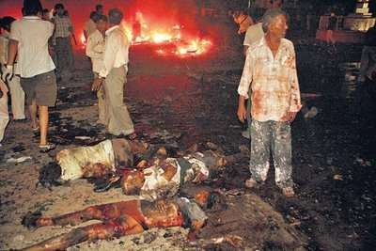
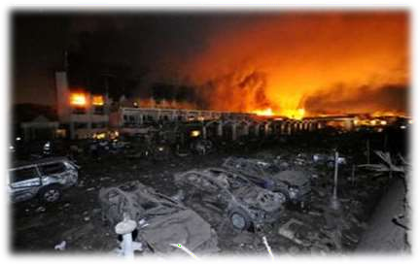
Ahmedabad Bomb Blast(26-07-08)
A mail with id alarbi_gujrat@ yahoo.com was being sent by a group of Terrorists.
Person named Kenneth Haywood’s unsecured WIFI router in his house was being misused by terrorists.
3 more mails were sent after the blast with the same misuse of unsecured WIFI routers.

Slide 18

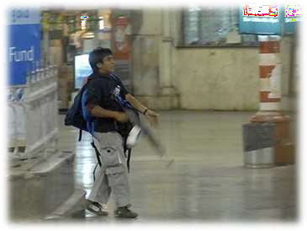
26/11 Mumbai Attack
Terrorists communicated with handlers in Pakistan through Callphonex using VoIP
(Voice over Internet Protocol).
The accused communicated to terrorists with an email id Kharak_telco@yahoo.com which was accessed from 10 different IP addresses

Slide 19
Black Out Day
It was first cyber war at “New York” city on 14th,August,2003
Real incidents that horribly suffered New York for 3 days
The hacker attacks on power lines
Before 3 days some one some where realize the virus named as “
BLASTER”
And it a self active
100 power plants are shut down
By the incident effects on whole traffic ,air line power ,water system & nuclear reactor too
New York government struggled 3 months to find the accused
That was Russian government is totally responsibility to this act

Slide 20
CYBER TERRORISM IN INDIA
ECIL(Electronic Corporation of India Limited) which was invented electro voting system in India , controlling parliament security system , Nuclear plants ,Defense etc.
ECIL CYBER website was hacked by Phrozenmyst
Not only ECIL and also ISRO ,BARC
The hacker Phrozenmyst was stolen sensitive data from ECIL and pasted on PASTEBIN website
And some other Cases.

Slide 21
Cyber terrorism against traditional terrorism
In the future, cyber terrorism may become a feasible option to traditional physical acts of violence due to:
Perceived anonymity.
Low risk of detection.
Low investment.
Operate from nearly any location.
Few resources are needed

Slide 22
How does Cyber Terrorism affect you and your future?
Air traffic control towers or our airlines infrastructure could be hacked into.
Banking systems could be violated and all of our money could be stolen.
Bombs and other explosives could be set off by remote.
Hospitals could lose all of their information.
Disclose of Government secrets and plans
The tampering of our water systems.

Slide 23

What do we need to do??
Maintain high alert & vigilance.
Update OS and applications regularly.
Set strong and complex passwords.
“Lock down" systems.
Keep anti-virus software installed and up-to- date.
Deploy intrusion detection systems and firewalls.

Slide 24
Prevention & Protection:
Be cautious about opening email attachments.
Complete Software Updates
Create difficult passwords
Download anti-virus software
Uninstall unused applications or services

Slide 25
CONCLUSION:
Cyber terrorism is a scary concept for many reasons.
It can do possible serious damages to various aspects of our lives. It is even scarier that cyber terrorism is so difficult to catch and track and prosecute.
The information age has brought us many good things, but along with those good things came some bad things too.
All we can do as citizens is to protect ourselves by protecting our information, who we give it to and how much we give it out.
Our government is trying to do its part, so let’s support them
and their efforts and stop this cyber battle.

Slide 26
Thank you all for your precious time

Slide 27
You can contact me at
Instagram: @biswajeetray7
Twitter: @BiswajeetRay7
My organization: @indian_cyber_ops {Instagram , Facebook, Twitter, Youtube}

